Slide 1







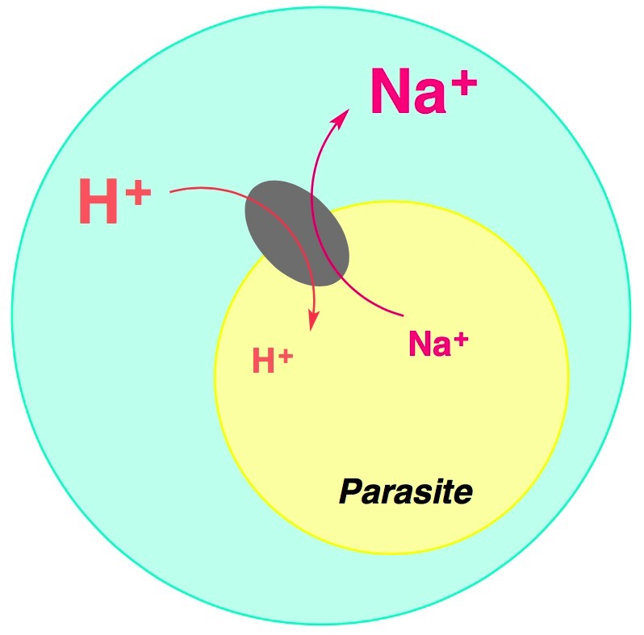

Open Source Malaria (OSM) Series 4:
in vivo active, public domain drug leads
Marat Korsik†, Edwin G. Tse†, David G. Smith†, Peter J. Rutledge†, Matthew H. Todd‡*
Email: opensourcemalaria@gmail.com
@marat_korsik, @edwintse_, @DavidSmithChem, @MatToddChem* from www.opensourcemalaria.org
†School of Chemistry, University of Sydney, Australia
‡School of Pharmacy, University College London, United Kingdom
1. An Open Source Drug Discovery Project
The Six Laws of Open Science
First law: All data are open and all ideas are shared
Second Law: Anyone can take part at any level of the project
Third Law: There will be no patents
Fourth Law: Suggestions are the best form of criticism
Fifth Law: Public discussion is much more valuable than private email
Sixth Law: The project is bigger than, and is not owned by, any given lab.
The aim is to find a good drug for malaria, by whatever means, as quickly as possible
Inspired by open source software development, the OSM project applies the same approach to science, a field that is historically very secretive and competitive. Research follows the ‘Six Laws’ (see right)¹ which, among other benefits, allows sharing of all generated data including unsuccessful results, something that would otherwise not be available to the public.
All experiments and raw data are posted in an online electronic lab notebook that can be accessed by you right now − just scan the QR-code!
GitHub/OpenSourceMalaria is used to plan the project.
Twitter/@O_S_M helps to reach out to collaborators.
github.com/OpenSourceMalaria/Series4/Wiki used to summarize developments in the project.
2. Series 4: Triazolopyrazines
3. Mode of action
The triazolopyrazine series originates from work performed at Pfizer. Many potent compounds with IC₅₀<0.050 µM were inherited and synthesised. Several compounds showed good in vivo activity. Toxicity testing against the hERG ion channel proved the compounds to be safe.
The Kirk laboratory at the Australian National University screened active and inactive compounds in an ion regulation assay and identified PfATP4 as the likely target for the Series 4 compounds. Binding to this protein is known to disrupt the sodium homeostasis of the parasite. Interestingly, several antimalarial compounds in development have been found to target this protein, yet no cross-resistance has been found through forced evolution experiments.²
The work presented here focuses on further exploration of the structure activity relationships (SAR) through variation of the aryl substituent in north-east area of the triazolopyrazine.
4. Exploration of 3-substituents in triazolopyrazine
5. Late stage biofunctionalisation by Pfizer
Late stage functionalization is a relatively new technique in medicinal chemistry: a method in which molecules showing good biological activity are randomly functionalized by chemical or biological means.
A number of OSM Series 4 compounds were subjected to the late stage biofunctionalisation by Pfizer.⁴ This was performed in microsomal cytosol, with resulting metabolites isolated by HPLC, with further tests by MS and NMR used to determine their structure. One of these metabolites showed very high antimalarial activity with an IC₅₀ value of 0.006 µM, making it the most potent compound in Series 4 so far. When chemically synthesised⁵, however, it showed an IC₅₀ = 0.659 µM. Further investigation is ongoing.
6. Tele-substitution in triazolopyrazines
Tele-substitution is a substitution reaction in which the entering group takes up a position more than one atom away from the atom to which the leaving group was attached.⁶ Reported for the first time in 1974 by M. Tisler,⁷ this reaction was recently found to be very important for this project, as a number of
Halogen | 5-substituted yield | 8-substituted yield
Chlorine | 70% | 4%
Bromine | 34% | 34%
Iodine | 23% | 54%
7. Further project goals
compounds were found to have been misassigned as a result of this unexpected substitution reaction. For instance, MMV693164 (originally misidentified as 5-substituted compound) was found to be completely inactive (IC₅₀ > 10 µM) but it was later revealed to be the 8-isomer. The actual 5-substituted compound MMV1581336 was found to be weakly active (IC₅₀ = 1.05 µM). The mechanism for this transformation has not been well studied, however Mark Coster (Griffith University) recently proposed the mechanism shown below.⁸ It has also been seen that bigger halogens favour the tele-substitution reaction.
Diversification Route
Join The Team:
References
¹ A.E. Williamson et al., ACS Cent. Sci. 2016, DOI: 10.1021/acscentsci.6b00086
² N.J. Spillman et al., Int J Parasitol Drugs Drug Resist 2015, 5, 149-162, DOI:10.1016/j.ijpddr.2015.07.001
³ GitHub/OSM_To_Do_List issue #390
⁴ GitHub/OSM_To_Do_List issue #513
⁵ GitHub/Series4 issue #36
⁶ https://goldbook.iupac.org/html/T/T06256.html accessed November 22, 2018
⁷ B. Vercek et al., Tetrahedron Lett., 1974, 51/52, 4539-4542, DOI: 10.1016/S0040-4039(01)92213-0
⁸ GitHub/Series4 issue #39
8. Way to get involved
You can simply scan the QR-code on the right to access OSM Series 4 GitHub page. Here you can check yourself how Open Science works and just reply to any discussion or start a new issue. Some of our collaborators synthesise desirable molecules in their spare time in the laboratory, others provide computational modeling to identify new targets for the anti-malarial screening.
If you would like to find out more you can contact us @O_S_M or leave a comment on the GitHub pages. Email is best avoided, but you can contact someone at opensourcemalaria@gmail.com if you would like to know more about what needs to be done next for Series 4 or if you'd like to run your own OSM project.
Acknowledgements
We thank The Medicines for Malaria Venture (MMV) and The Australian Government for a Linkage grant. We also thank all members of the OSM team (opensourcemalaria.org).

